Slide 1
“hitrekkers: The Ultimate Guide for Trekkers”
Presented By:
Manoj Acharya
Pankaj Bhattarai
Prabash Paudel
Pramod Khatiwada

Slide 2
Introduction
A recommendation engine.
A digital guide with concise content.

Slide 3
Problem Definition
To get the best trekking destination recommendation.
The organized content.

Slide 4
Objectives
To recommend the perfect destination.
To provide the concise content.

Slide 5
Scope and Limitations
A better platform for the trekkers.
Recommends trekking destination to the users according to their query.
Limitations
Difficulty in ranking places(different perception).

Slide 6
Feasibility Analysis
To confirm the current system is feasible or not according to different factors such as;
Economic Feasibility
The system is economically feasible.
Operational Feasibility
It is feasible into real world implemented system.
Technical Feasibility
It is technically feasible.

Slide 7
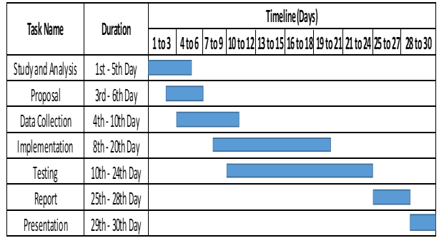
Schedule Feasibility
Following Gantt chart shows the proposed schedule to perform the project.

Slide 8
Requirement Analysis
Functional Requirement
Information of places.
Users requirements.
Non-Functional Requirement

Slide 9
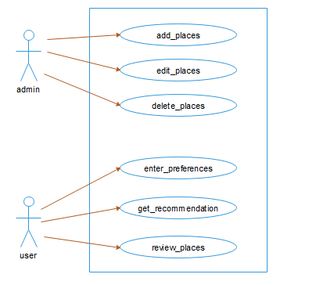
Use-Case Diagram

Slide 10
Algorithm Implementation
Cosine Similarity
The formula for calculation is:
Cos (a, b) = (a.b)/ (||a||×||b||)
where, ||a|| and ||b|| are the Euclidean norms of vectors a and b, respectively, and a. b is dot product between vectors a and b.

Slide 11
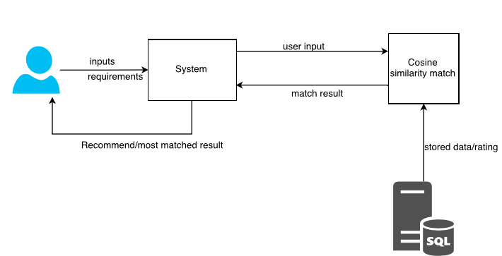
Block Diagram

Slide 12
Implementation Tools
HTML, CSS, BOOTSTRAP
PHP: Laravel and Sublime Text
MySQL and XAMPP Server
Edraw Max

Slide 13
ANY QUERIES?? Thank You!!

